Slide 1


Slide 2
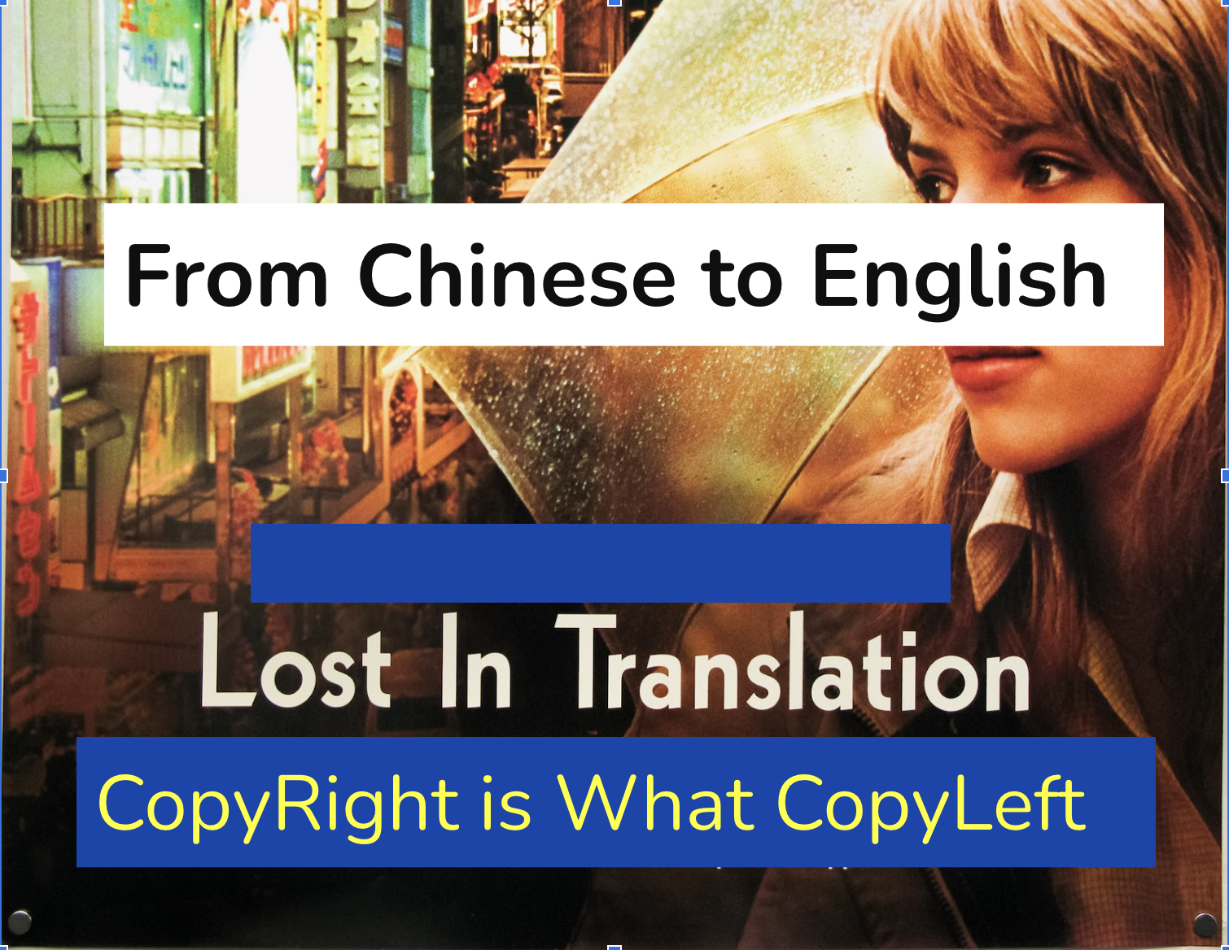
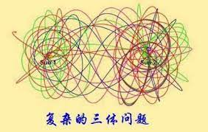
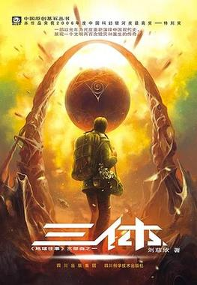
From Chinese to English
<Three Body Problem>
Lost In Translation
—From Chinese To English
CopyRight is What CopyLeft

Slide 3
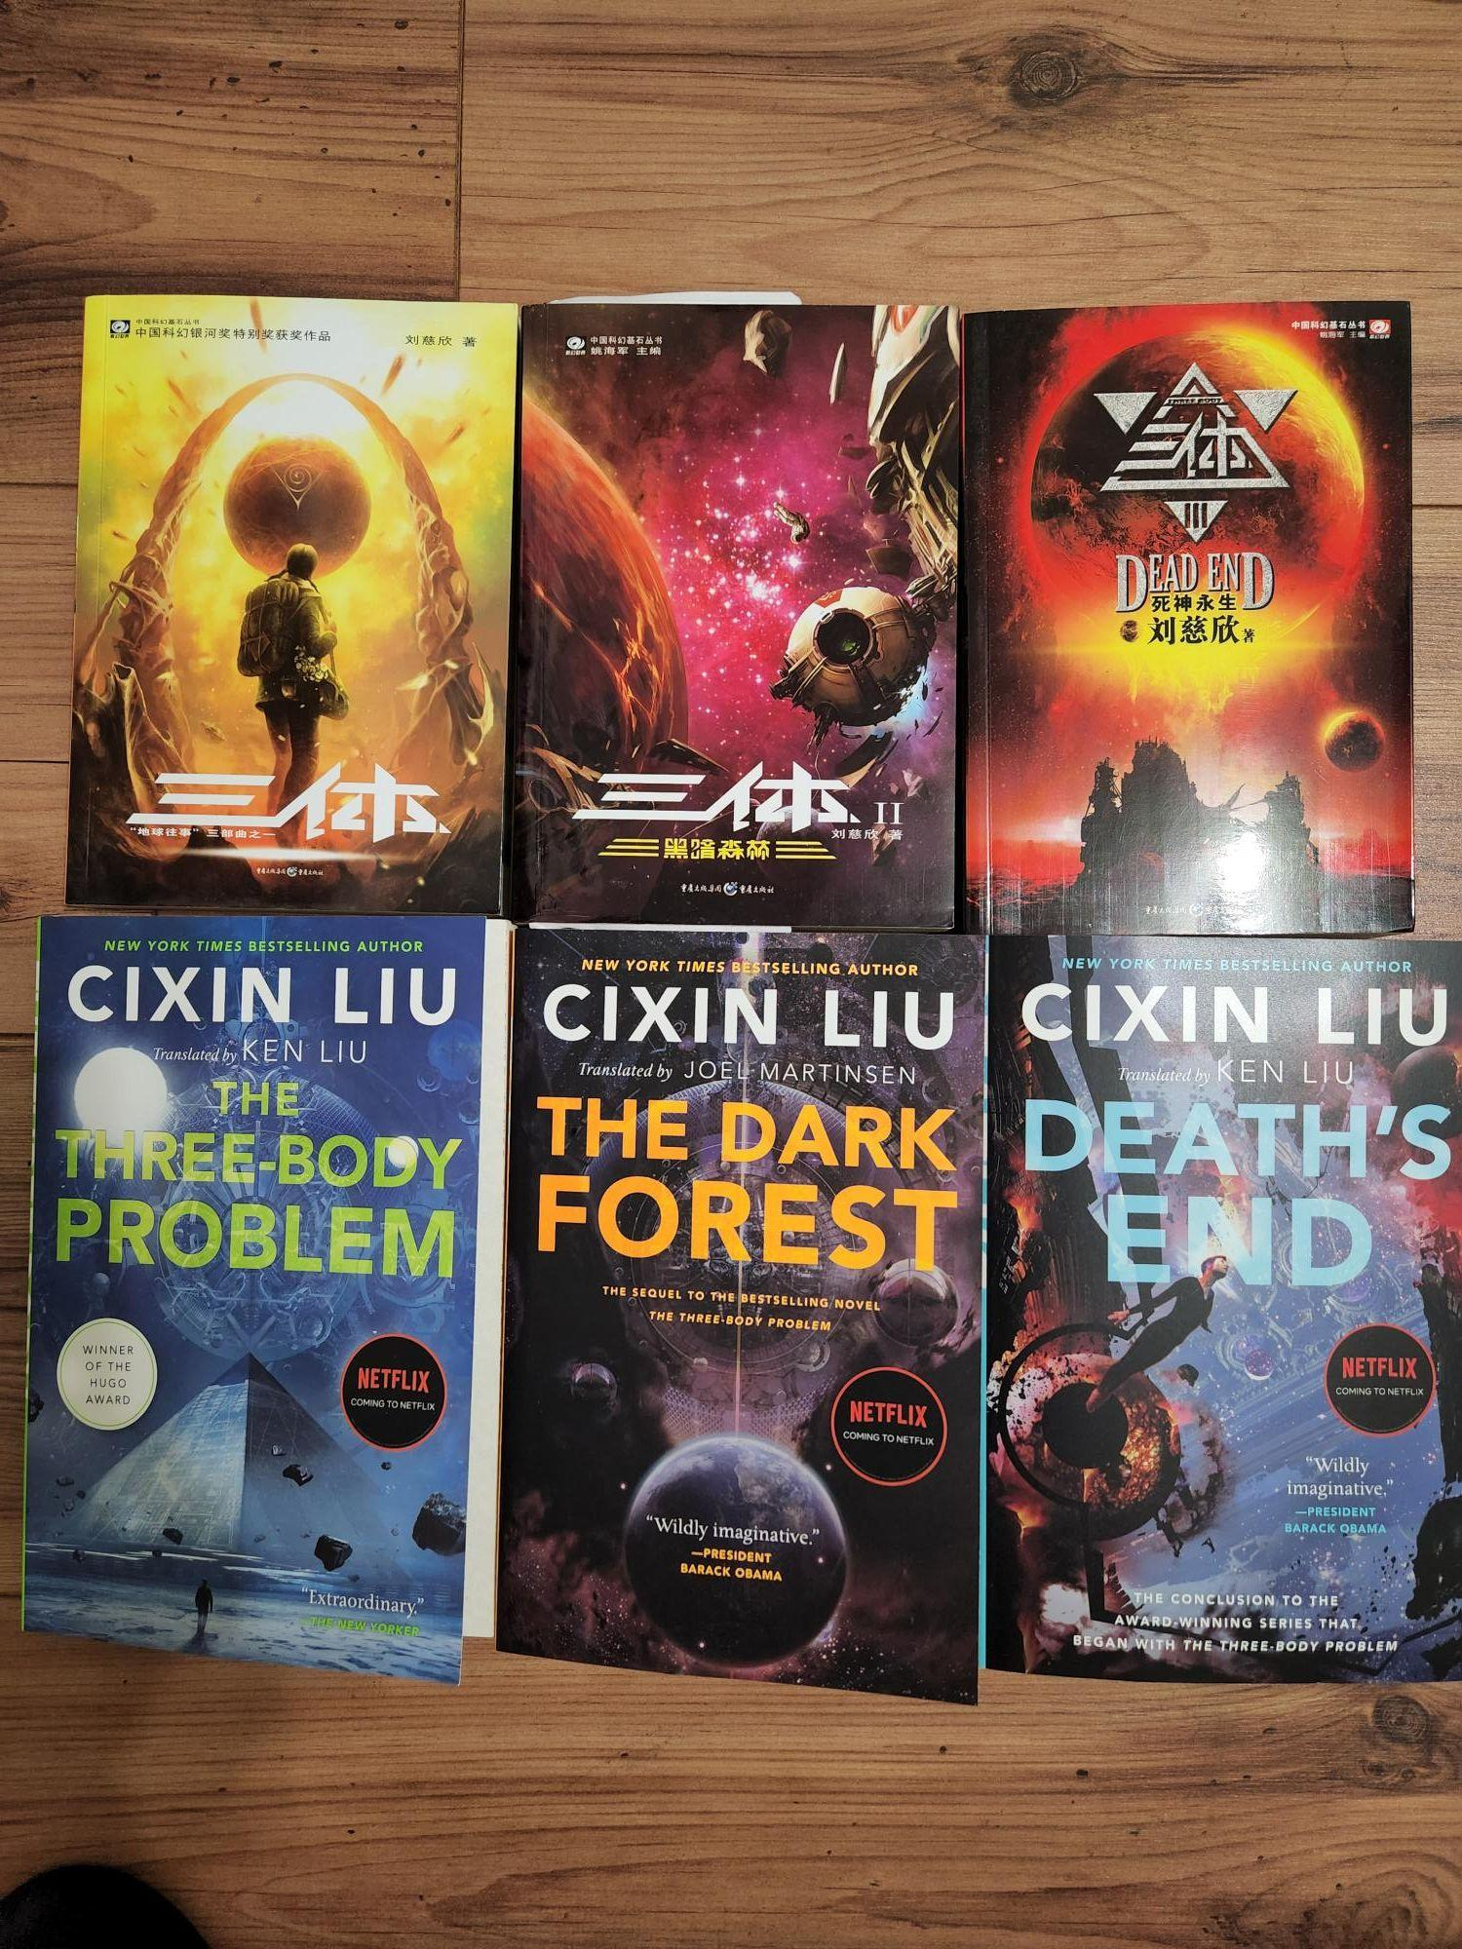
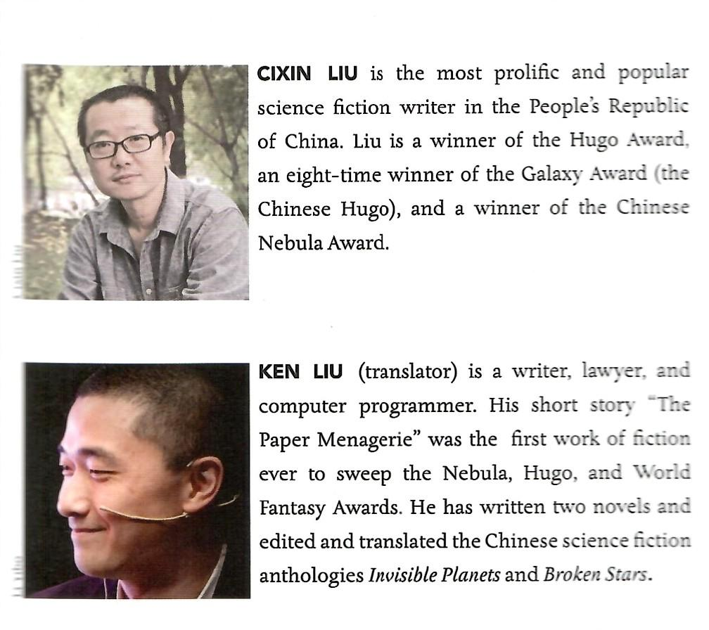

Slide 4
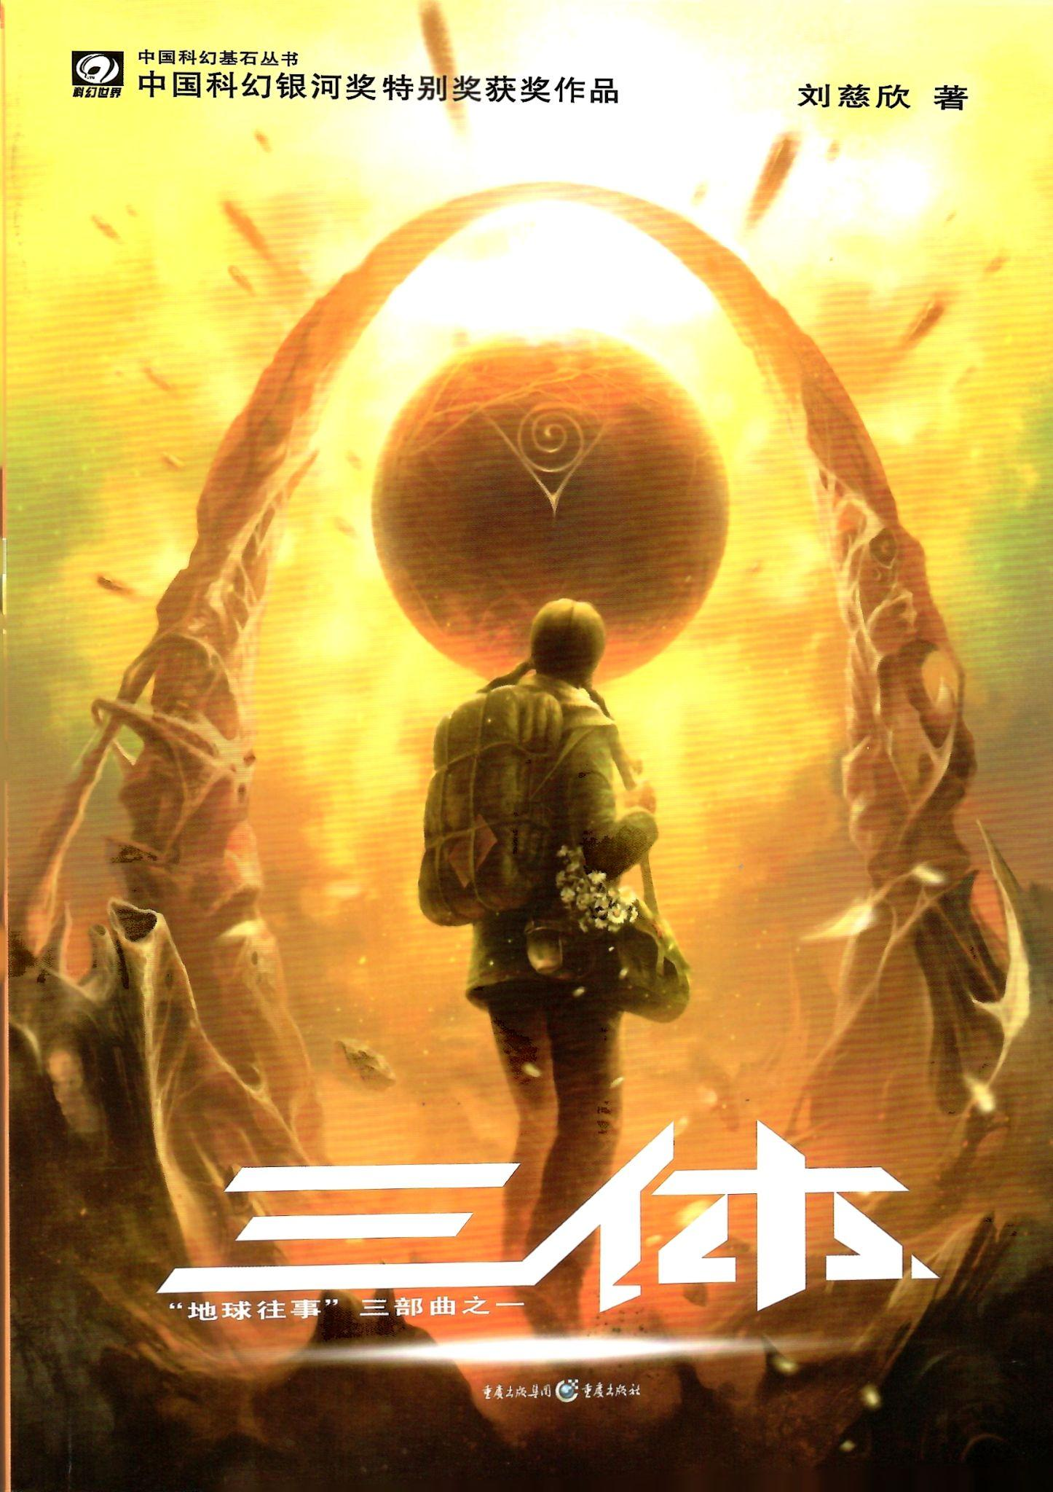
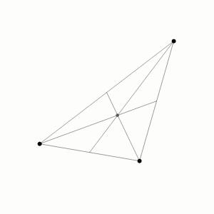
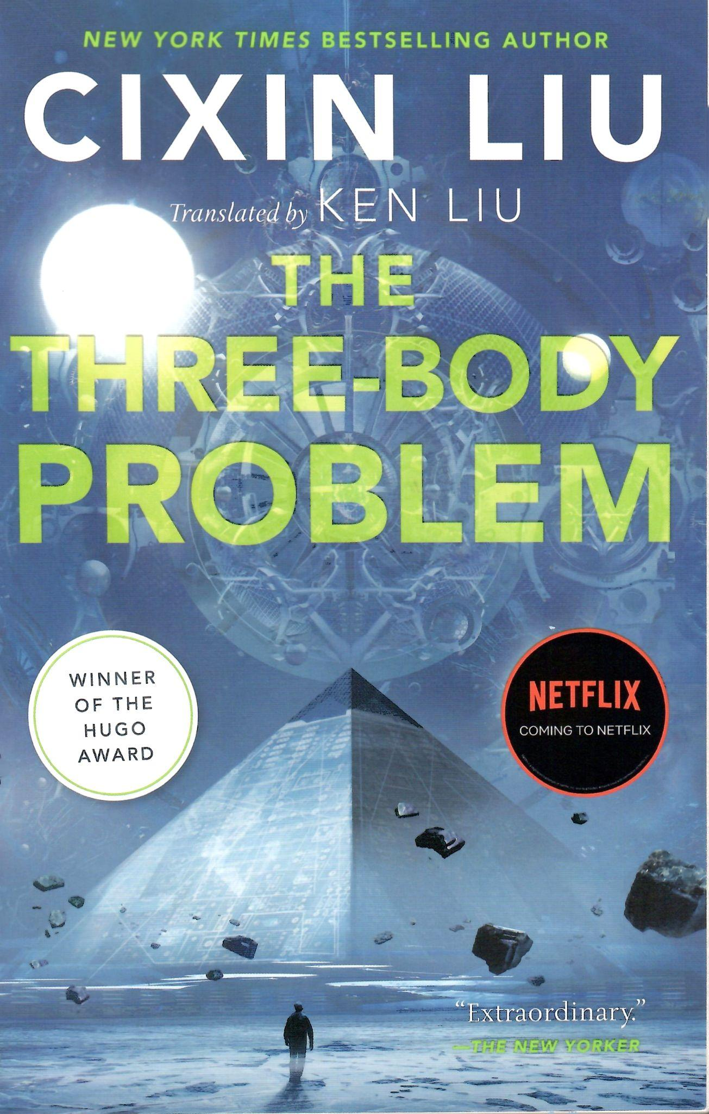
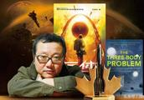

Slide 5
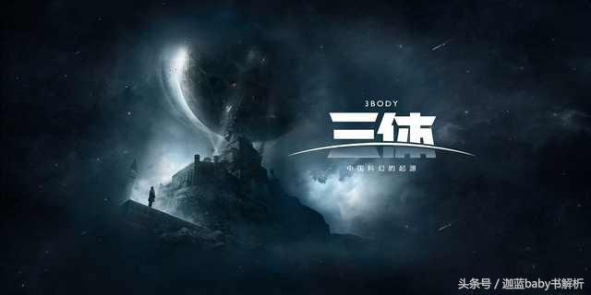

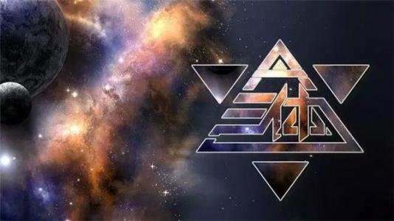

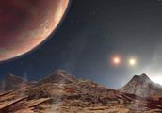

Top military project to search ET
An alien civilization at brink of destruction receives signal and plans to invade earth…
They have three suns in their system, therefore they are called Trisolaris.

Slide 6
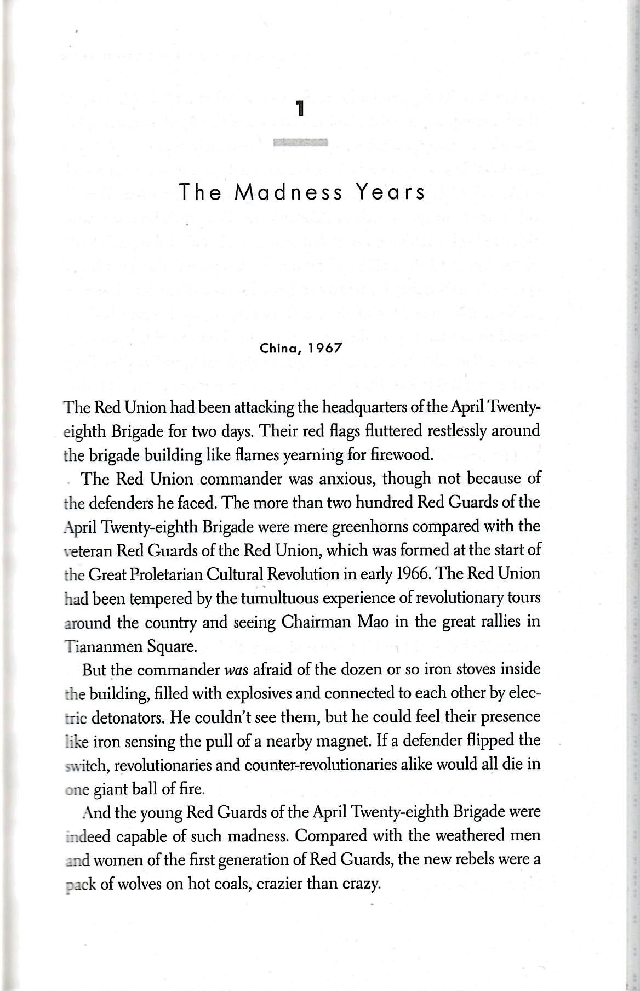
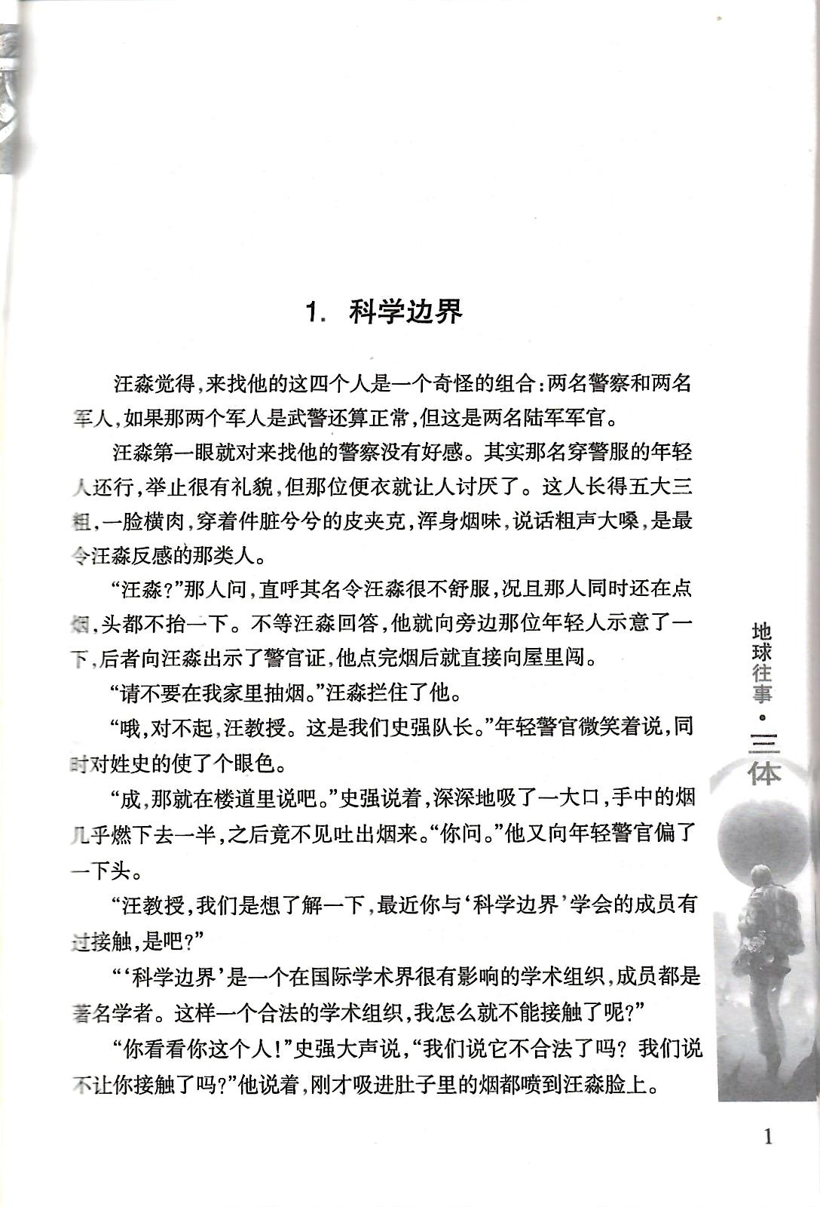
Why start with Ye WenJie?
Why change order of chapters? Better storytelling? Setup a tone?

Slide 7
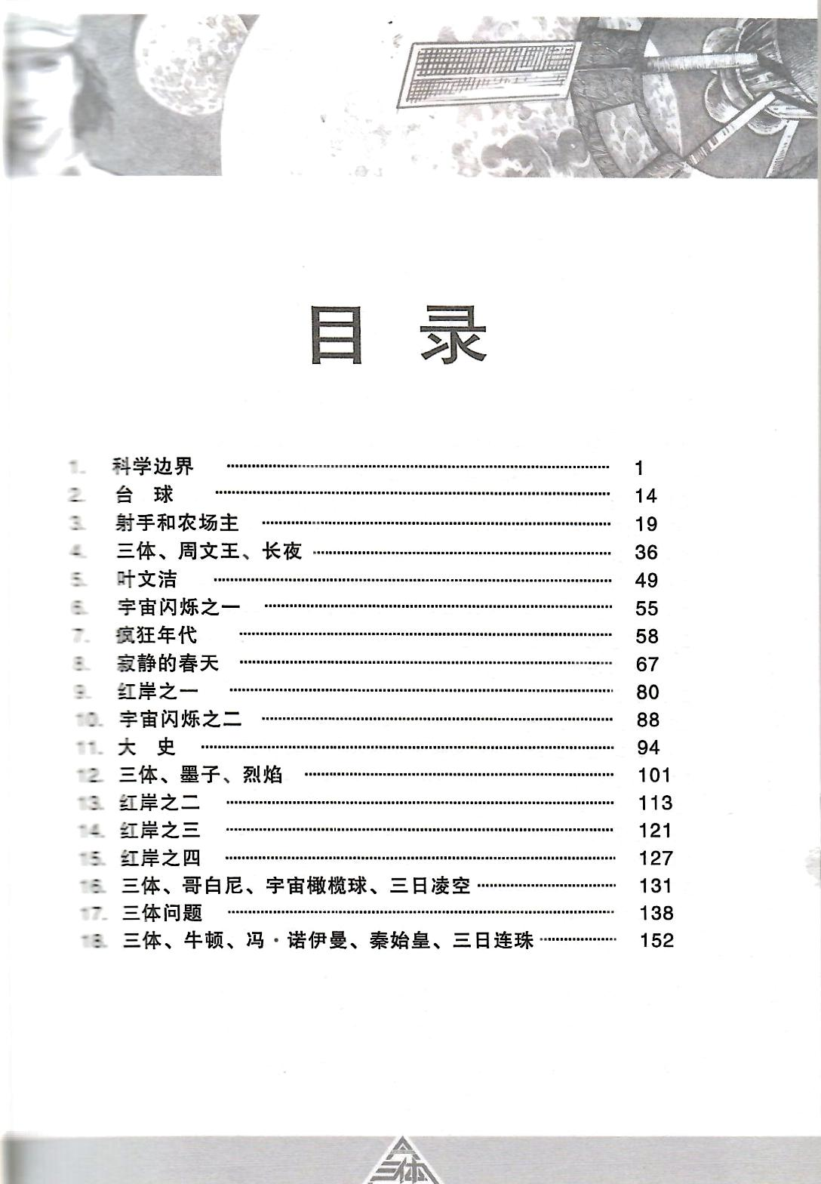

The index of chapters are missing because English version changes the order of chapters.
7,8,9
English version adds “parts”.

Slide 8
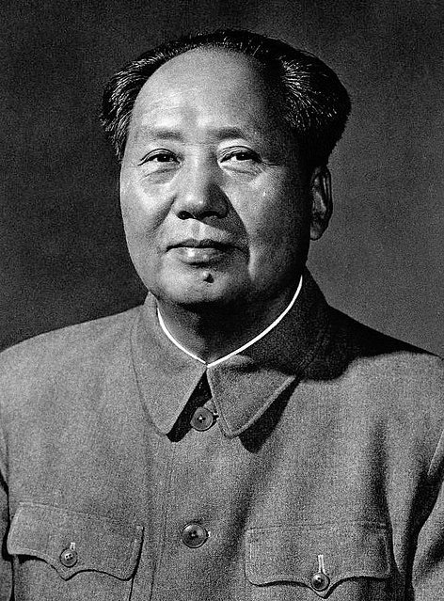
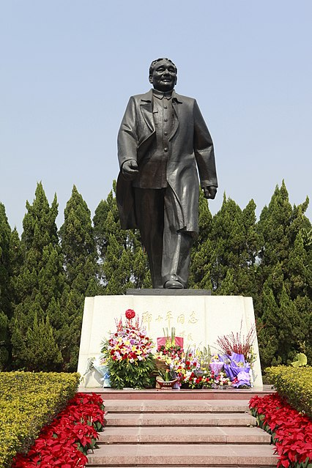
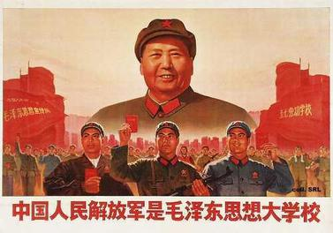
Scar literature or literature of the wounded (Chinese: 伤痕文学; pinyin: shānghén wénxué) is a genre of Chinese literature which emerged in the late 1970s during the "Boluan Fanzheng" period, soon after the death of Mao Zedong, portraying the sufferings of cadres and intellectuals during the experiences of the Cultural Revolution and the rule of the Gang of Four.
Scar Literature

Slide 9
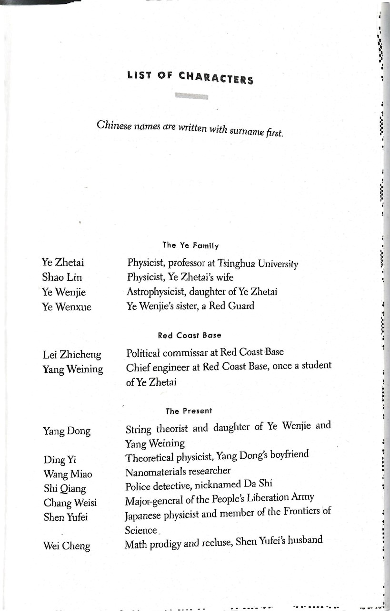
How to translate name of characters?
Why is name of character is so important? It is like a symbol name of your variable. A good function name explains many pages of documents.
What is lost in translation?
In ancient Chinese novel, each character comes along a poem which summarizes the character’s characteristic and fate. And it is not uncommon that the name of character implies that.

Slide 10
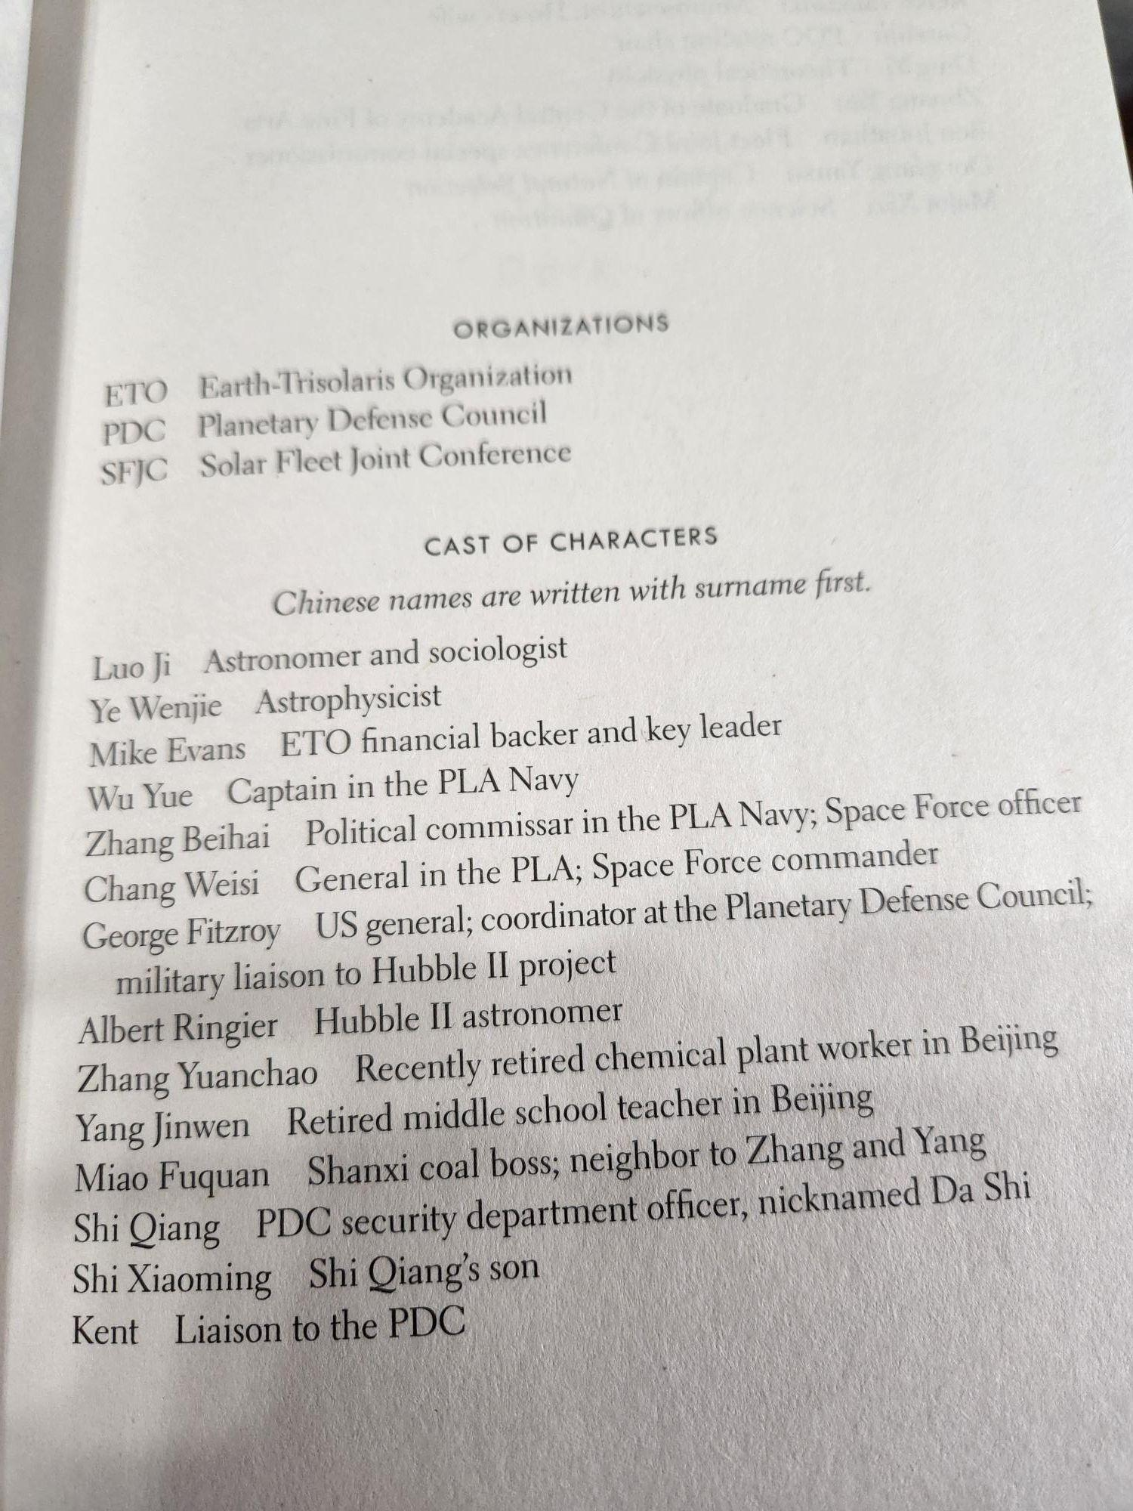
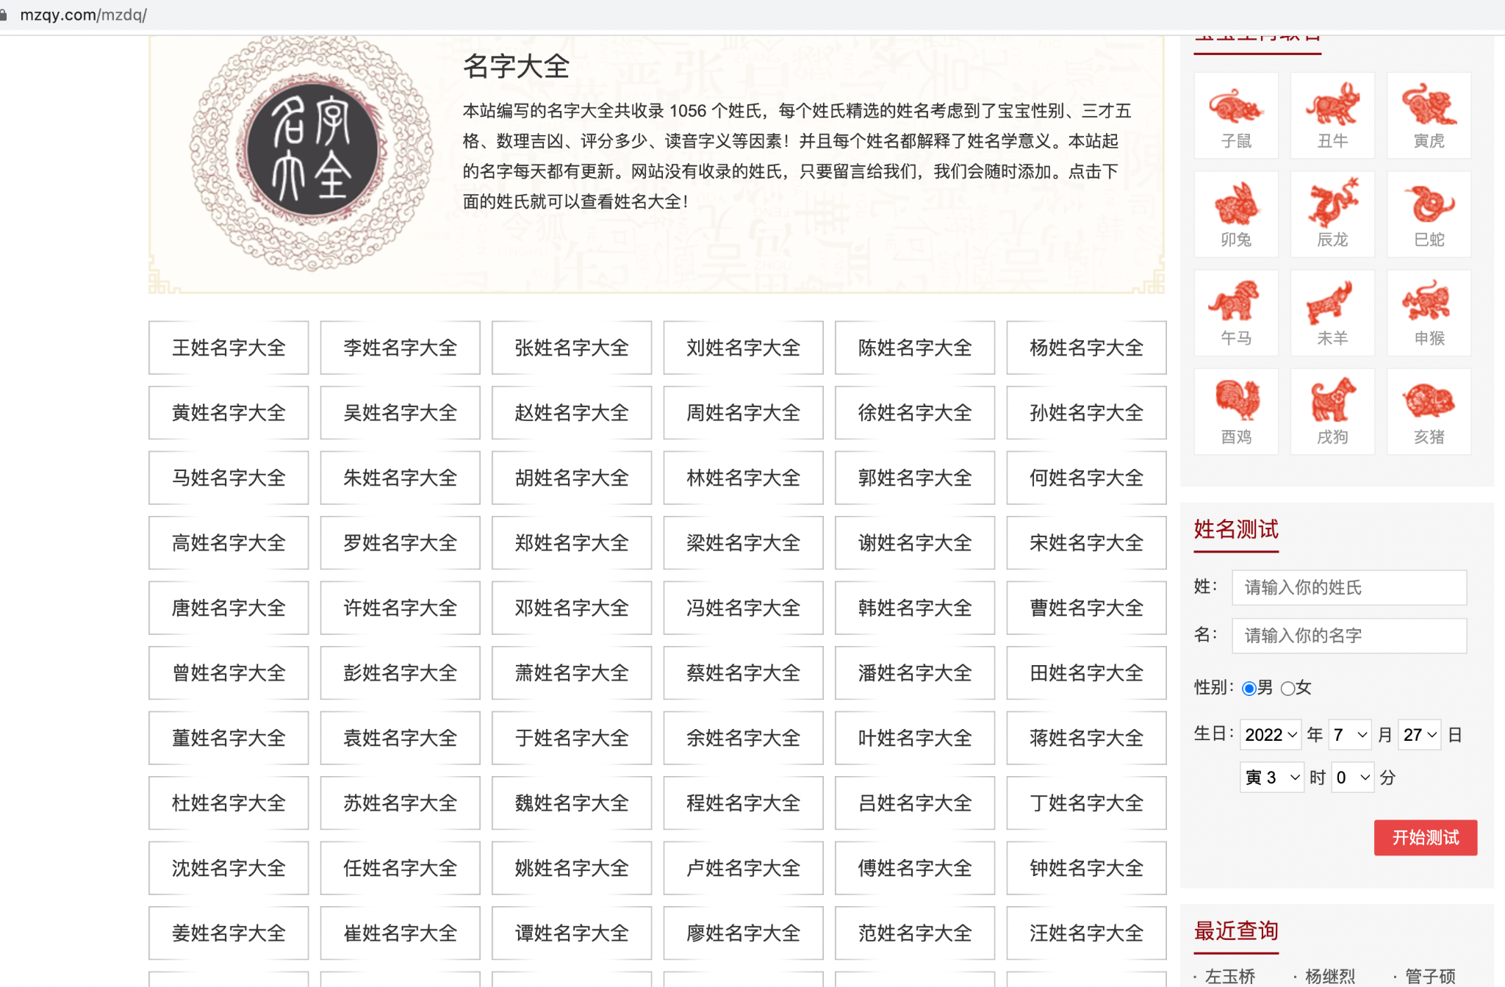
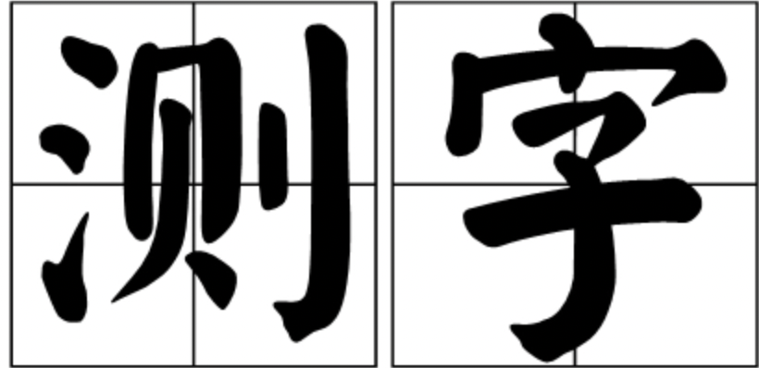
名字 name
拼音 pinyin

Slide 11
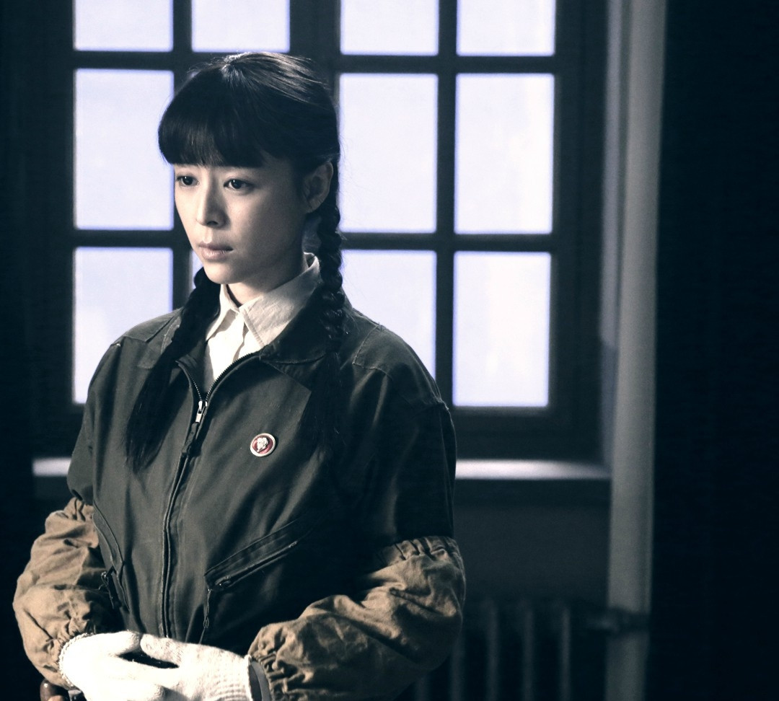
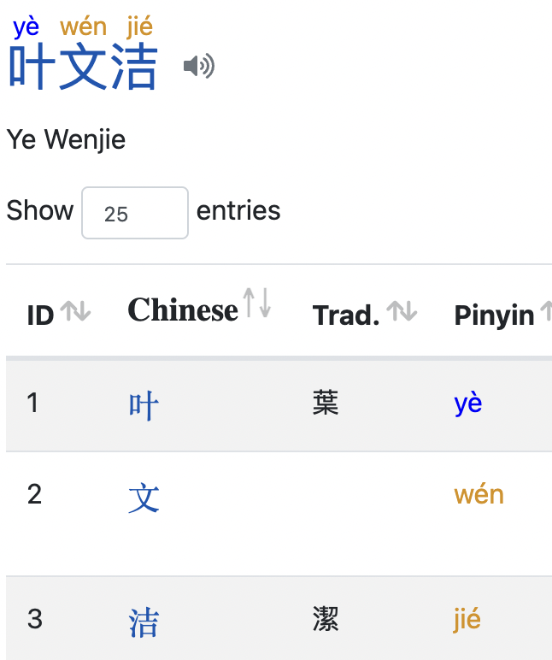
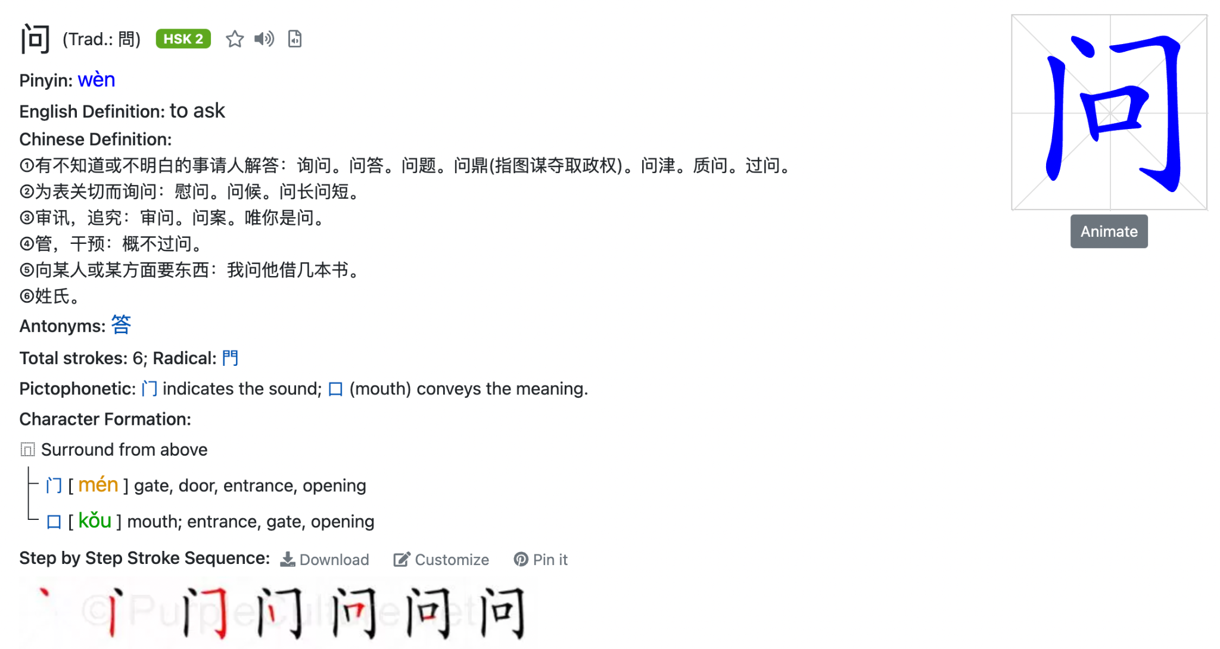
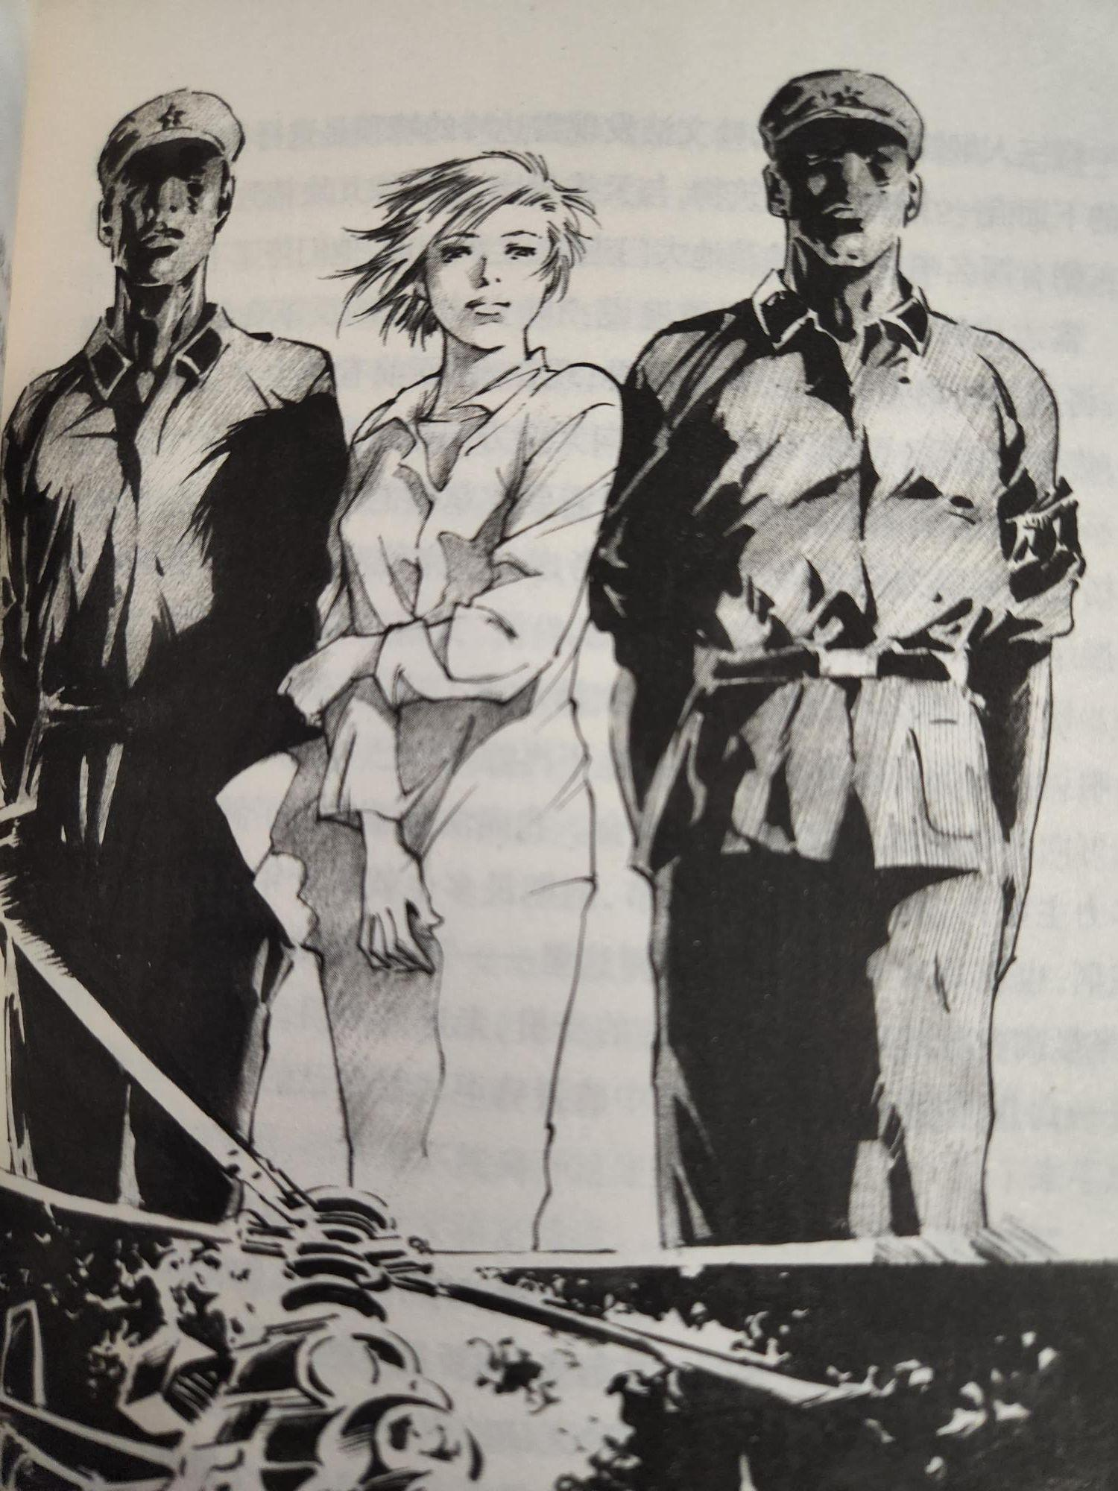
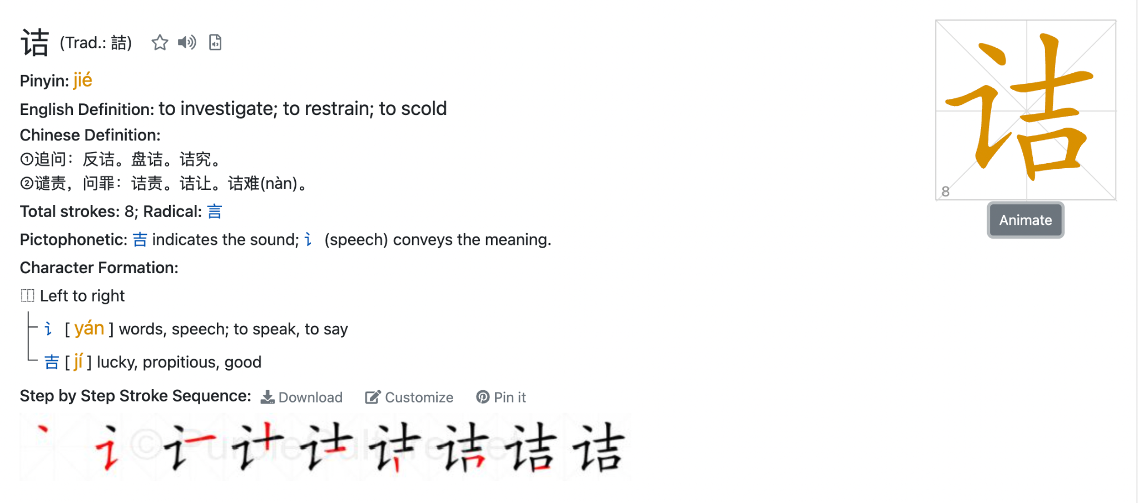
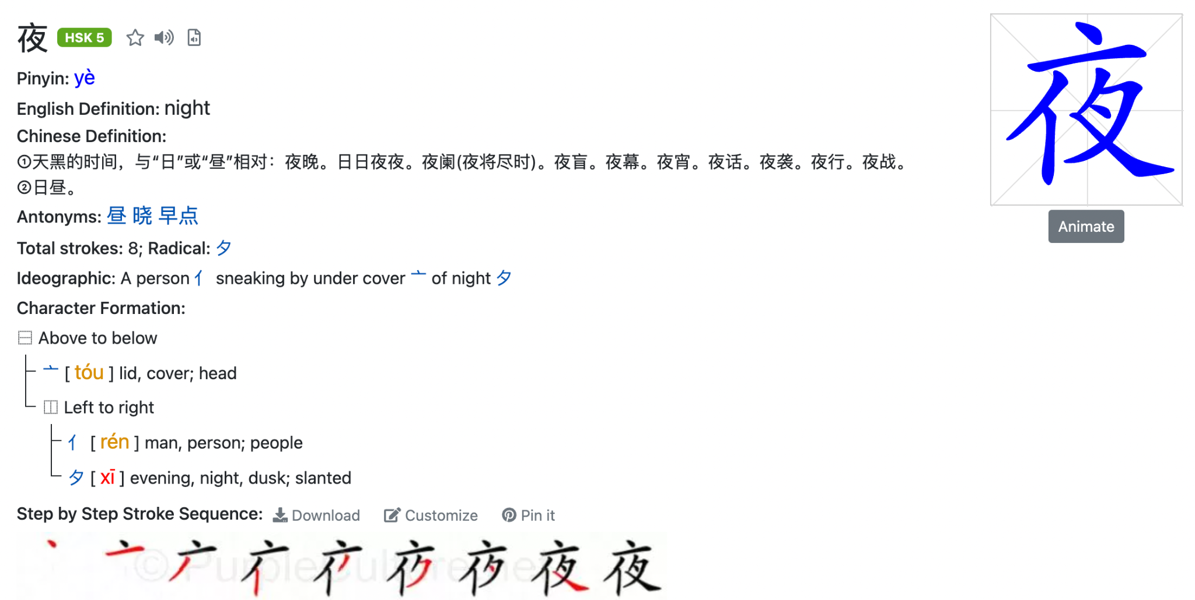


Slide 12
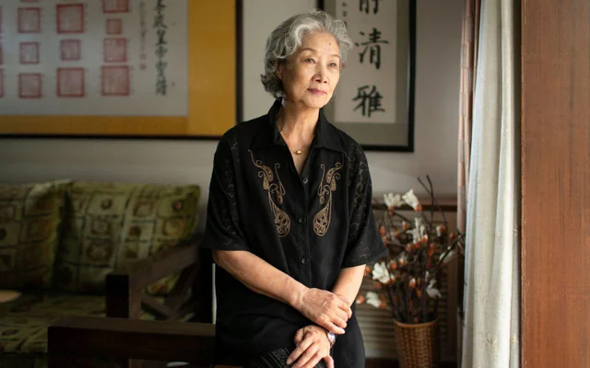
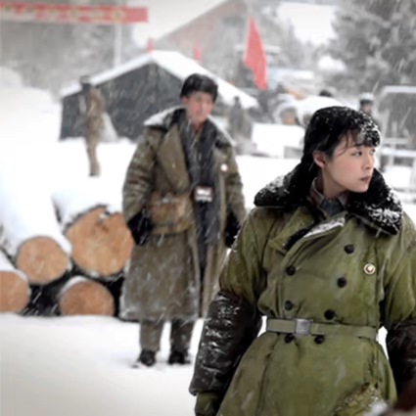

叹《三体》悲剧人物叶文洁(YE WENJIE)
“夜，问诘”(night,questioning)
DO NOT REPLY!
DO NOT REPLY!
DO NOT REPLY!
天道渺茫夜无边，
寰宇怨气问苍天。
三体无心伐桀纣，
怨女有悔乱人间。
At Night, Questioning
Mystery sky, endless night.
Hatred bursts out to question devine.
She hopes to destroy tyrant governance,
whiles her savior has no intentions.
Has she regretted her reckless avengence?

Slide 13
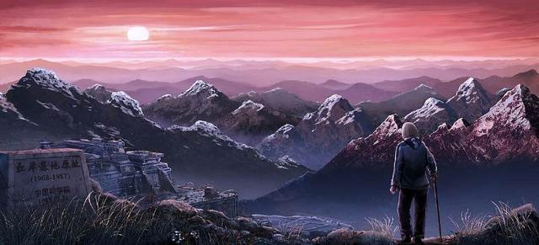
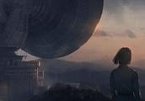
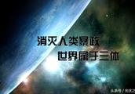
消灭人类暴政，世界属于三体!
Eliminate human tyranny!
The world belongs to Trisolaris!
Is more advanced civilization bringing more justice and fairness? No! Survival is the only purpose of civilization.
The ending sentence of novel…
“My sunset,” Ye whispered. “And sunset for humanity.”
消灭你 与你无关
Destroying your species has nothing to do with your species.

Slide 14
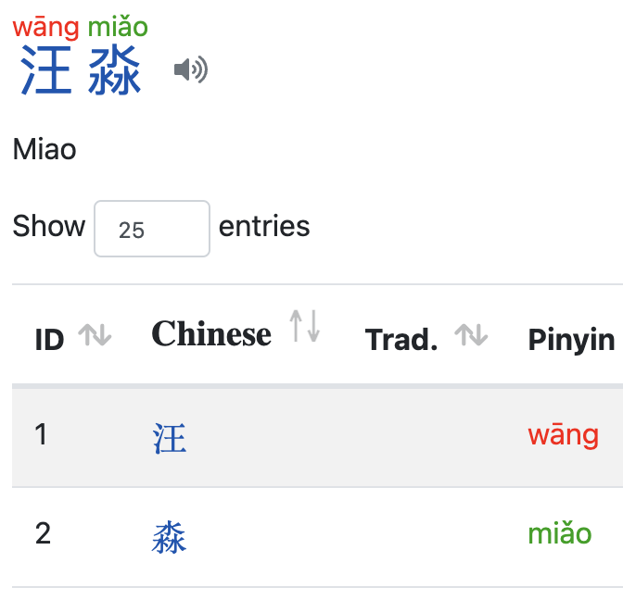

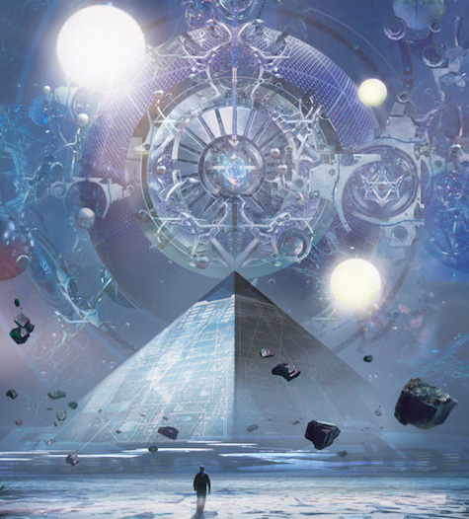
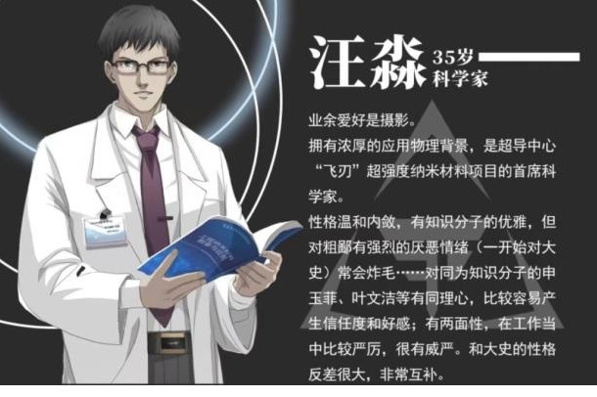
赞《三体》主人公汪淼(GREAT OCEAN)
上善若水纳百川，
纳米英才拯人寰。
只因心中有执念，
不惧怪神不信仙。
MICRO
Login id: HAIREN
海人
Sea man
Like water, like way.
Only humble gets away.
Hero of nano-material saves macro world.
Only faith in heart can face daemon in head.
弱小和无知不是生存的障碍 傲慢才是
Weakness and ignorance are not obstacles to survival, but arrogance is.
HUMBLE
LOW KEY

Slide 15
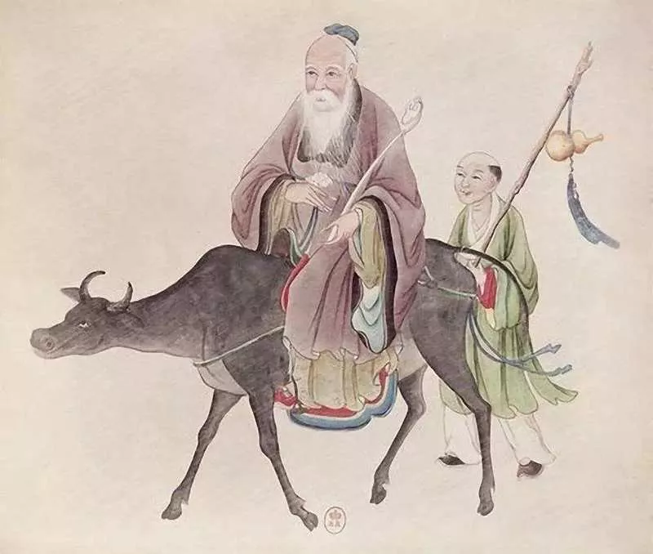
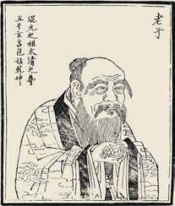

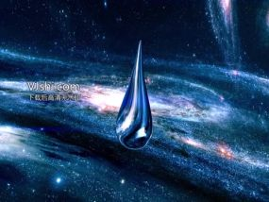
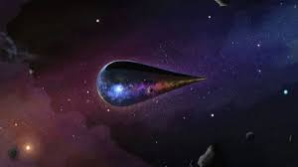
江海所以能为百谷王者，以其善下之
The reason of sea can be king of hundreds of valley is that it is good at lowering itself.
The highest goodness is like water
天下之至柔，驰骋天下之至坚。
The extreme softness overcomes the extreme hardness.

Slide 16
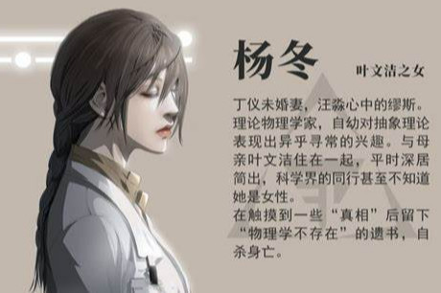
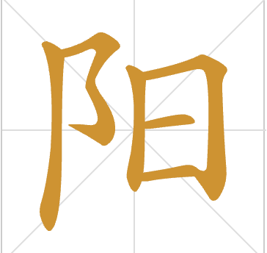

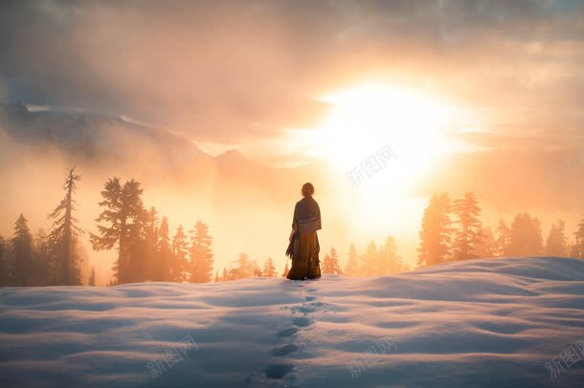
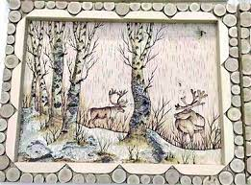
YANG DONG
Sunshine Winter
Her name implies "Sunshine in Winter" which reflects Ye WenJie's last hope for human society because "sunshine in winter" does not warm one's body, merely giving the feeling of warmth.
And when Sophon finally lockdown technology advancement by interfering all Colliders all over world, YangDong finally gives up her life because of her words: "If physics doesn't exist, then what's meaning of living?"

Slide 17
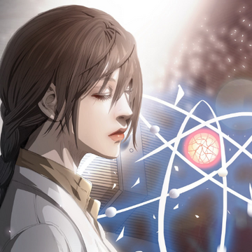
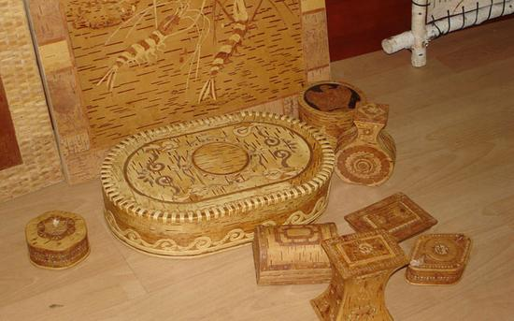
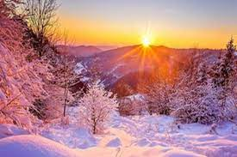
叹《三体》悲剧人物杨冬。
----人物名字暗含"冬日残阳"，隐喻她是主人公叶文洁对于人类社会最后一点希望如寒冬残阳般的一点点若有若无的暖意，而当女儿杨冬因为智子干扰对撞机结果锁死人类科技进步后绝望自杀后也就失去对人世最后的希望而选择毁灭人类的道路。
寒冬残阳遗腹子，
与世隔绝如白纸。
白桦作纸树当床，
一生献给纯物理。
微观探究有边界，
智子干扰对撞机。
物理规律不存在，
信念崩溃选择死。
Sunshine in winter,
Life is like white paper,
Her whole life is devoted into physics,
Yet there is no law in Quantum Mechanics,
In science, she loses faith,
In life, she chooses death.

Slide 18
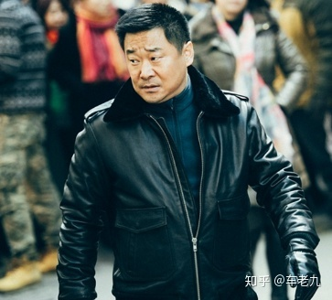
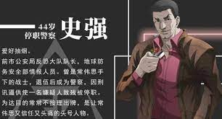
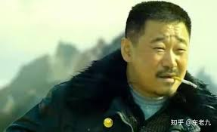


史强 Shi Qiang
STRONG
赞《三体》英雄人物史强(STRONG)
杀伐决断敌胆寒，
忠义无边美名传。
生逢乱世何所惧？
舍生向死凯歌还。
邪乎到家必有鬼。
Anything sufficient wierd must be fishy!
Ruthless killer to enemy, faithful guard for friend.
Scares nothing in chaos, because only those who has been to hell can be back to heaven.

Slide 19



史强(STRONG)
Kill and decide like live Yama,
Wisdom unparalleled ruthless role.
Does one thing come down to another?
The wicked have their own grind
赞《三体》英雄人物史强(STRONG)
杀伐决断活阎罗，
智计无双狠角色。
一物本来降一物？
恶人自有恶人磨。

Slide 20





Shen Yu Fei
叹《三体》悲剧人物申玉菲
------这里作者暗喻该人物的真实名字“伸翅膀欲飞冲天”也就是“伸欲飞”，这自然就是预言了人物悲剧的命运了。
Her name implies “stretching out her wings in an attempt of flying up” which is a symbol of tragic fate of a trapped soal.
身世迷离冷雪霜，
一心救主想断肠。
欲飞广寒借仙药，
陨落星辰梦不长。
Stretch out attempt to fly
Mythery life colder than ice,
To save her savior whole-heartedly,
Fall like a star even before her dream just starts.

Slide 21


罗辑
放浪形骸本无羁，
宇宙真理唯逻辑。
面壁执剑一甲子，
石刻历史写传奇。
A playboy with irrational life,
Discovered the truth of the universe is only by logic.
Facing the wall with a sword for 60 years,
The history of stone carvings writes legends.
罗辑 Luo Ji
（逻辑）Logical
基本公理(Basic Axioms)
生存是文明的第一需要。Survival is primary need of civilization.
文明不断增长和扩张，但宇宙中的物质总量保持不变。Civilization continuously grows and expands, but the total matter in the universe remains constant.
Mutual Assured Destruction
(MAD)

Slide 22





黑暗森林法则 Dark Forest Rule
技术爆炸
Technological Explosion
猜疑链
Chains of Suspicion
Balance of Terror

Slide 23




我们的征途是星辰大海...
Our journey is the oceans of ​​stars…
ZHANG BEIHAI
The 5th hidden wall-facer. Thinking, thinking, and thinking more…
没关系，都一样的。
It doesn’t matter, all the same!
Most foresightful human leader

Slide 24





There is a fish in Beiming, and its name is Kun. Kun is so big, I don't know how many thousands of miles it is. Turned into a bird, its name is Peng. Peng's back, I don't know how many thousands of miles it is, it flew in anger, and its wings were like clouds hanging from the sky. It is a bird, and the sea will migrate to the Nanming.
Lurking at bottom of BeiMing Ocean.
Great expectation yields great expedition.
Hibernating for a hundred years just waiting for the east wind.
北冥有鱼，其名为鲲。鲲之大，不知其几千里也。化而为鸟，其名为鹏。鹏之背，不知其几千里也；怒而飞，其翼若垂天之云。
赞章北海
北冥有海养鲲鹏，
壮怀广宇欲远征。
坚毅隐忍堪大用，
百年蛰伏待东风。
大鹏一日随风起，扶摇直上九万里
One day, Giant Peng rises along with wind,
Swirling up 90000 miles

Slide 25





Cheng Xin 程心 (诚心）Honest
福至心诚圣母心，
孰料三体本无情。
心软难堪大才用，
地球往事漂流瓶。
How lucky is a girl with heart of Virgin Mary,
If only she knew Trisolaris has no heart.
Soft-minded leader cannot be expected with great responsibility,
And she is only good to send earth memoir in Drifting Bottle.

Slide 26






Ding Yi 丁仪 (D1)
A, B, C and D ranked first,
Catch water droplets in a spaceship.
Sophon locks the atom smasher,
Professor of 100 years old still teaches physics.
丁仪
甲乙丙丁排第一，
太空船里捉水滴。
智子锁死加速器，
百岁教授教物理。

Slide 27
References
https://www.zhihu.com/question/25654998
https://www.purpleculture.net/chinese-english-dictionary/
https://en.wikipedia.org/wiki/The_Three-Body_Problem_(novel)

